Slide 1
Image-guided Navigation for Robotics
Test Driven Development
Rachel Sparks, Ph.D.
Rachel.sparks@kcl.ac.uk
Lecturer in Surgical & Interventional Engineering
School of Biomedical Engineering & Imaging Sciences

Slide 2
Overview
Describe what is test driven development and the theory behind it
Show a minimal working example – Computing the average of a set of points
Show a practical exampled in 3D Slicer – Target point selection

Slide 3
What is a test?
A piece of code that validates a piece of code is functioning properly
Ensure correct output given a known input
The best test are simple, theoretically known
Three types of test
A unit of code (i.e. function) behaves as expected: Unit Test (sanity check)
A set of code works together : Integration Test
The entire software package works: System Test

Slide 4
Software Development Best Practices
Unit Tests are fundamental to
Detecting errors (bugs) early in development cycle
Detecting code responsible for bug
Best Practice is to have 100% test coverage
Every line of code is tested by at least 1 unit test
Test all possible scenarios
Minimum number of unit test per line of code

Slide 5
Traditional Software Development Cycle
1. Define purpose
2. Write code
3. Write Unit Test(s)
double ComputeMean(
vector<double> numbers)
{
double mean = 0;
for each element in numbers
{
mean = mean + numbers[i];
}
mean / numbers.size();
return mean;
}
myAwesomeNumber = ComputeMean({1});
Throw error if myAwesomeNumber != 1;
manyNumbers = ComputeMean({1, 2, 3});
Throw error if myAwesomeNumber != 2;
Compute mean from a set of numbers.
Unit Tests fails

Slide 6
Traditional Software Development Cycle
1. Define purpose
2. Write code
3. Write Unit Test(s)
double ComputeMean(
vector<double> numbers)
{
double mean = 0;
for each element in numbers
{
mean = mean + numbers[i];
}
mean / numbers.size();
return mean;
}
double ComputeMean(
vector<double> numbers)
{
if numbers empty return NAN;
double mean = 0;
for each element in numbers
{
mean = mean + numbers[i];
}
mean / numbers.size();
return mean;
}
myAwesomeNumber = ComputeMean({1});
Throw error if myAwesomeNumber != 1;
manyNumbers = ComputeMean({1, 2, 3});
Throw error if myAwesomeNumber != 2;
noNumbers = ComputeMean({});
Throw error if myAwesomeNumber != NAN;
Compute mean from a set of numbers.
Unit Tests fails

Slide 7
Traditional Software Development Cycle
Initial code writing more difficult without Unit Tests
Unable to characterize if code is fit for purpose
Unable to detect when code refactoring causes error
Leads to extraneous code not related to code functionality
Poorer test coverage
Difficult to assess if unit test covers all relevant uses
Difficult to know if all portions of code are being assessed

Slide 8
Advantages of Test Driven Development?
Ensures test coverage – you cannot write code until you have a unit test for it
Forces developer to define code purpose with granularity before starting to code
Reduces unnecessary code
Ensuring no code for scenarios that are not possible
Enables developers to identify gaps in test coverage easier

Slide 9
Test Driven Development Theory
One component of modern software development systems including, eXtreme Programming (XP) [1] and Agile [2]
Comparisons of software development among Computer Science students showed [3]
Developers who use TDD have greater unit test coverage
Developers write more lines of code per hour, have fewer bugs, and spend less time debugging.
[1] Kent Beck. Extreme Programming Explained: Embrace Change (2000)
[2] Robert C. Martin. Agile Software Development, Principles, Patterns, and Practices (2002)
[3] Erdogmus, Hakan; Morisio, Torchiano. "On the Effectiveness of Test-first Approach to Programming". Proceedings of the IEEE Transactions on Software Engineering, 31(1). January 2005.)

Slide 10
Test Driven Development – Averaging Example
Only write the minimum amount of code that will make the test successfully pass
Write better test
1. Define purpose
2. Write Unit Test
3. Write code
myAwesomeNumber = ComputeMean({1});
Throw error if myAwesomeNumber != 1;
double ComputeMean(
vector<double> numbers)
{
mean = numbers[0];
return mean;
}
Compute mean from a set of numbers.
Unit Tests fails

Slide 11
Test Driven Development – Averaging Example
Only write the minimum amount of code that will make the test successfully pass
Write better test
1. Define purpose
2. Write Unit Test(s)
3. Write code
double ComputeMean(
vector<double> numbers)
{
mean = numbers[0];
for remaining numbers in list
{
mean = mean + number[i];
}
return mean / numbers.size();
}
myAwesomeNumber = ComputeMean({1});
Throw error if myAwesomeNumber != 1;
manyNumbers = ComputeMean({1, 2, 3});
Throw error if myAwesomeNumber != 2;
double ComputeMean(
vector<double> numbers)
{
mean = numbers[0];
return mean;
}
Compute mean from a set of numbers.
Unit Tests fails

Slide 12
Test Driven Development – Averaging Example
Only write the minimum amount of code that will make the test successfully pass
Write better test
1. Define purpose
2. Write Unit Test(s)
3. Write code
myAwesomeNumber = ComputeMean({1});
Throw error if myAwesomeNumber != 1;
manyNumbers = ComputeMean({1, 2, 3});
Throw error if myAwesomeNumber != 2;
noNumbers = ComputeMean({});
Throw error if myAwesomeNumber != NAN;
double ComputeMean(
vector<double> numbers)
{
if numbers empty return NAN;
mean = numbers[0];
for remaining numbers in list
{
mean = mean + number[i];
}
return mean / numbers.size();
}
Compute mean from a set of numbers.
Unit Tests fails

Slide 13
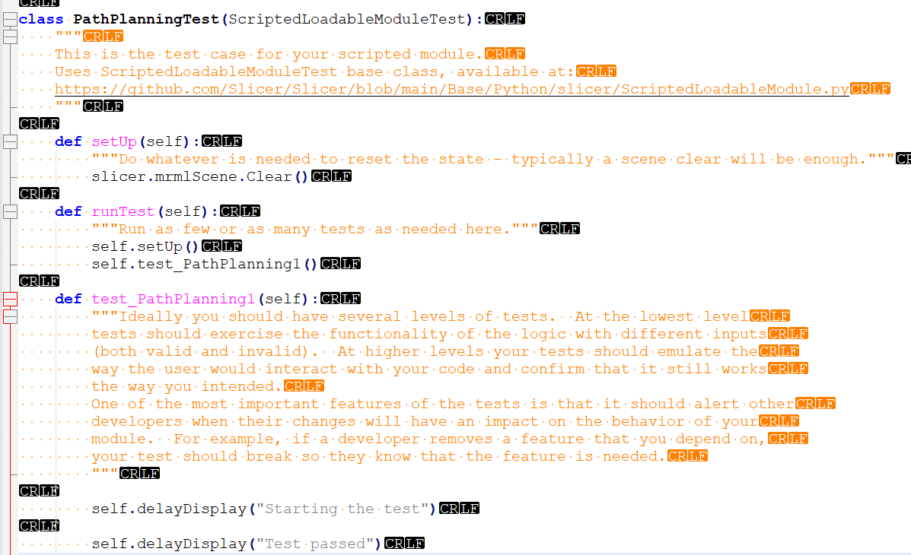
Test Driven Development – 3D Slicer Considerations
All modules made through
ExtensionWizard have a Test class.
Test class is initialized and “runTest” is called when “Reload and Test” is pressed in UI
We have a setUp and then different tests

Slide 14
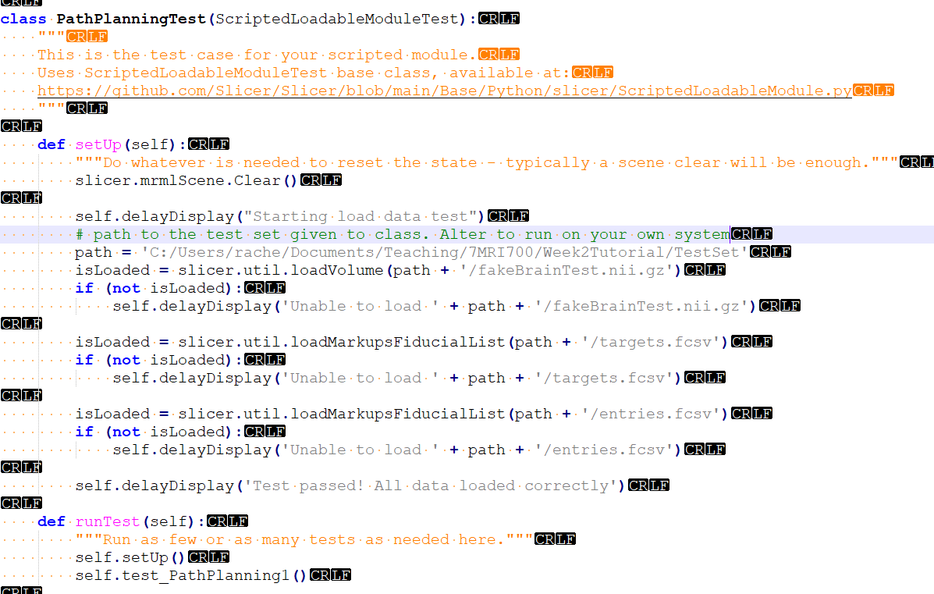
Test Driven Development – 3D Slicer SetUp
The setup function is where you must
Clear the mrml Scene if you would like to remove data that may cause unintentional problems (remember this will reset the data you have loaded!)
Load in data that you would like to use for the test
Best practice is to put data on a repository somewhere and download from the internet
For this class you can hard code the data location – just make sure to comment so I know what code to change

Slide 15
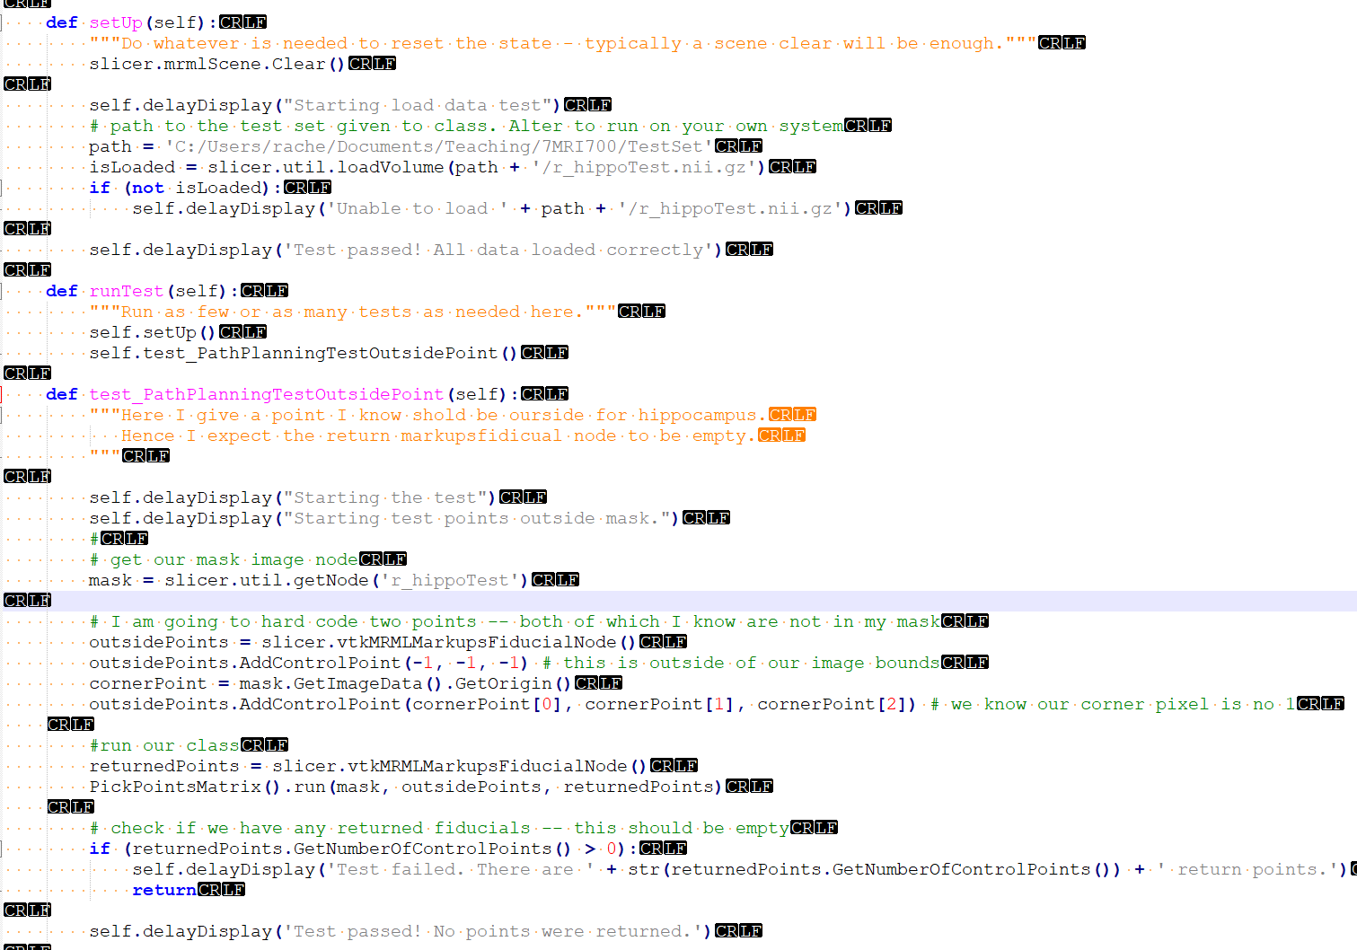
Test Driven Development – 3D Slicer Tests
For test make it as simple as you can
Known inputs/outputs
Try to test an individual function in a class
This should be done for logic classes and functions
This is an example of a negative test – I know the points should return false
For completeness you need positive and edge tests
Notes:
Here pause to ask students what would be a positive test? What would be an edge test?

Slide 16
Summary
We learned what is test driven development and
Demonstrated a minimal working example – Computing the average of a set of points
Demonstrated a (longer) practical exampled in 3D Slicer – Target point selection which you can know find in SlicerWeek2Tutorial/PathPlanning (don’t forget to pull from the repo first!)

